Slide 1
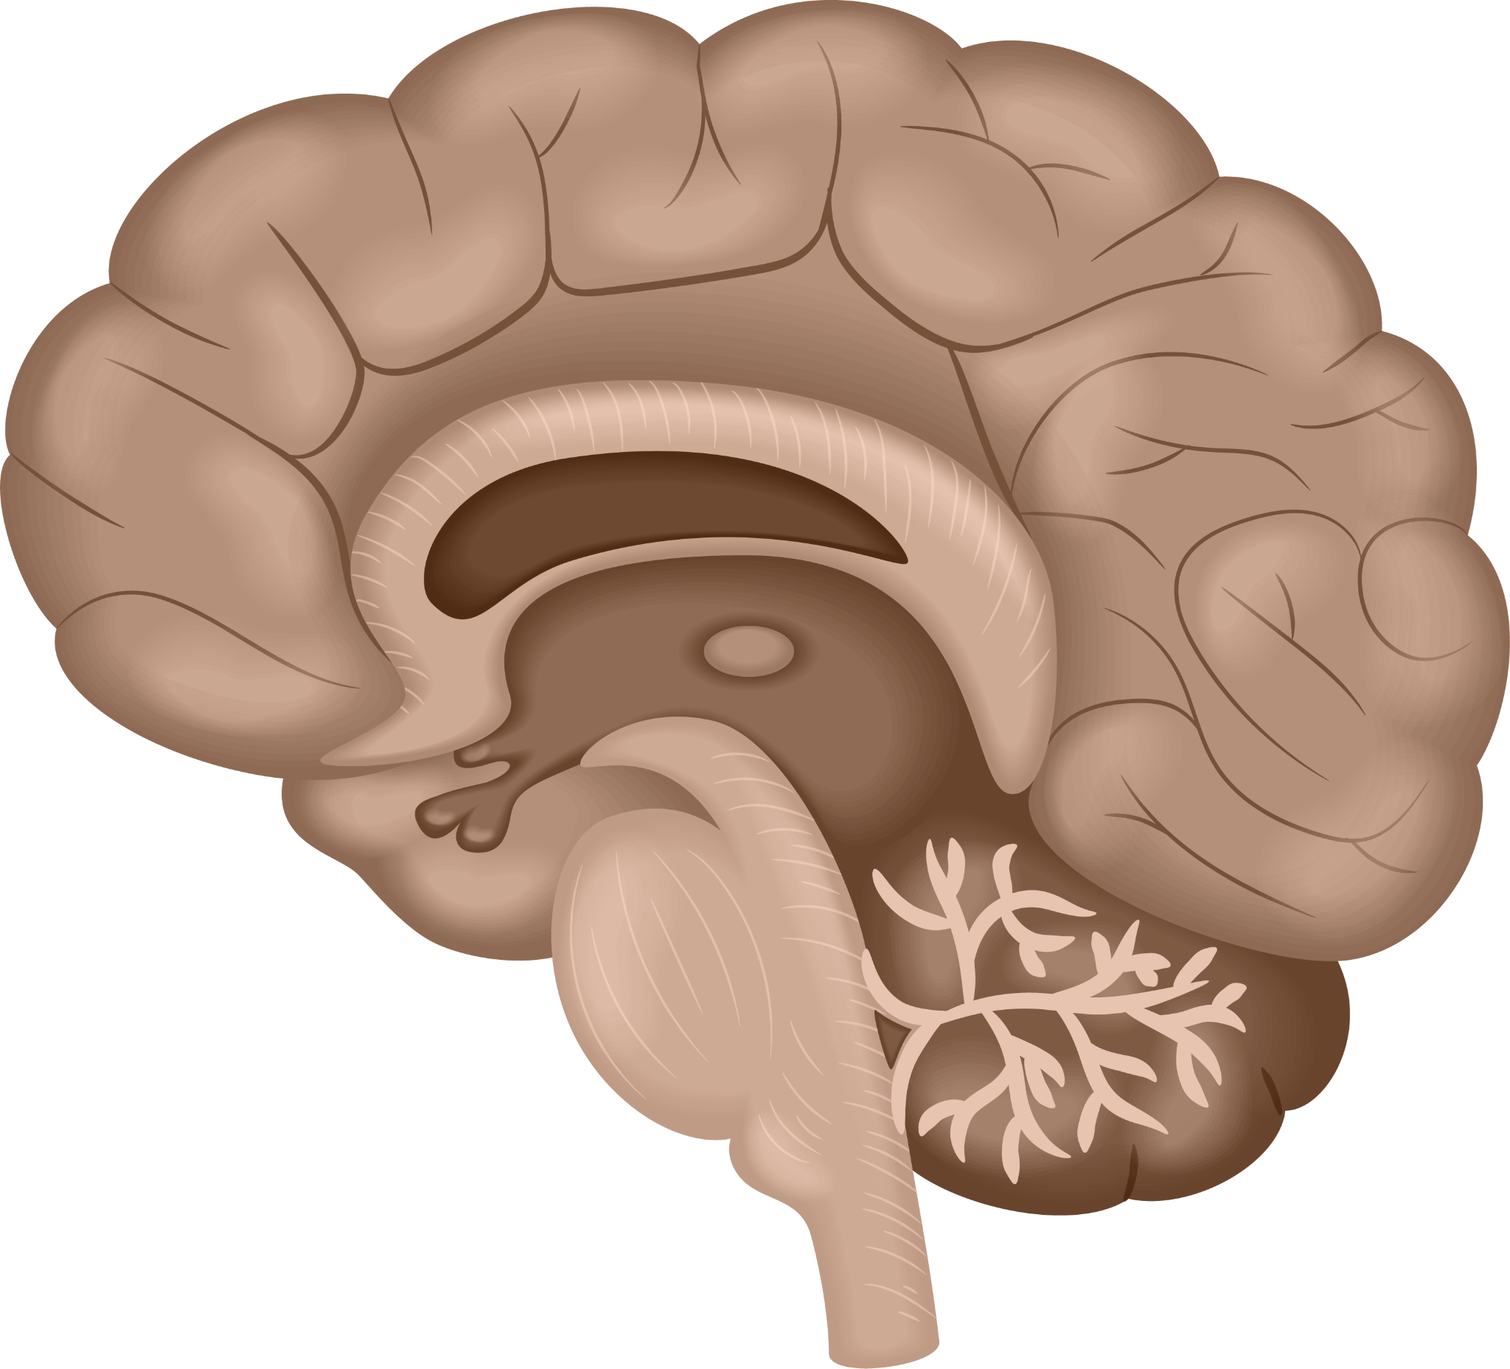
Brain tumor detection
Wiem Sayeh
Sofiene Sallemi
Mohamed Hakmouni
Montaha Ammar
GI3S3

Slide 2
Introduction
Detect brain tumors from medical images.
Use machine learning and image processing.
Compare different retrieval and classification methods.
Goal: improve robustness and accuracy.

Slide 3
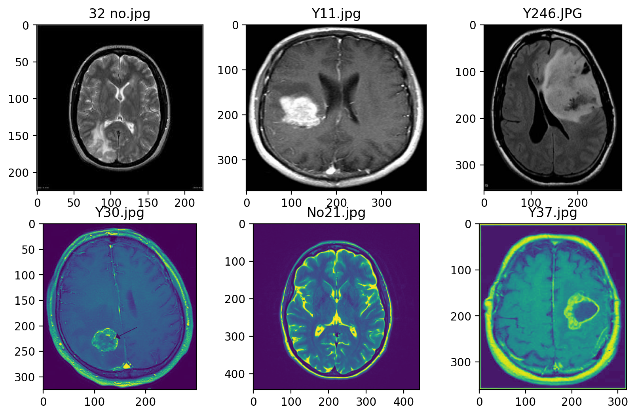
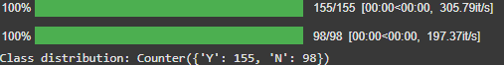

Slide 4
whole image retrieval
This approach compares the whole input image directly with images in the dataset
Take each pixel as a feature and give the entire pixel vector to a classifier
Resize it to a fixed size (224×224).
Convert to grayscale (single channel).
Flatten the image into a 1D vector (size 50 176).

Slide 5
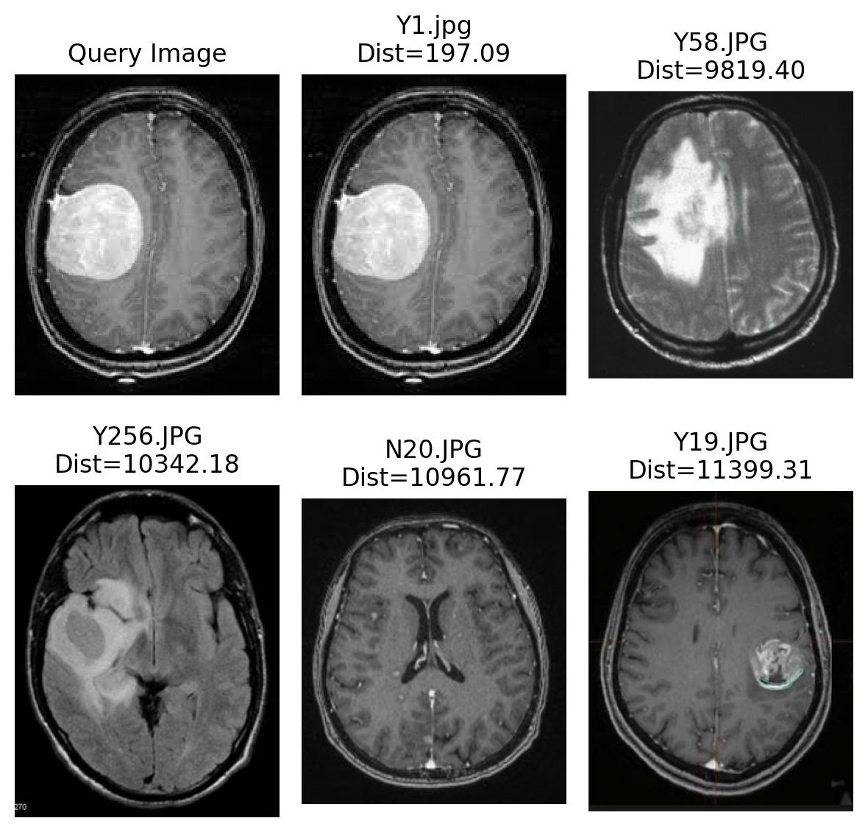
whole image retrieval

Slide 6
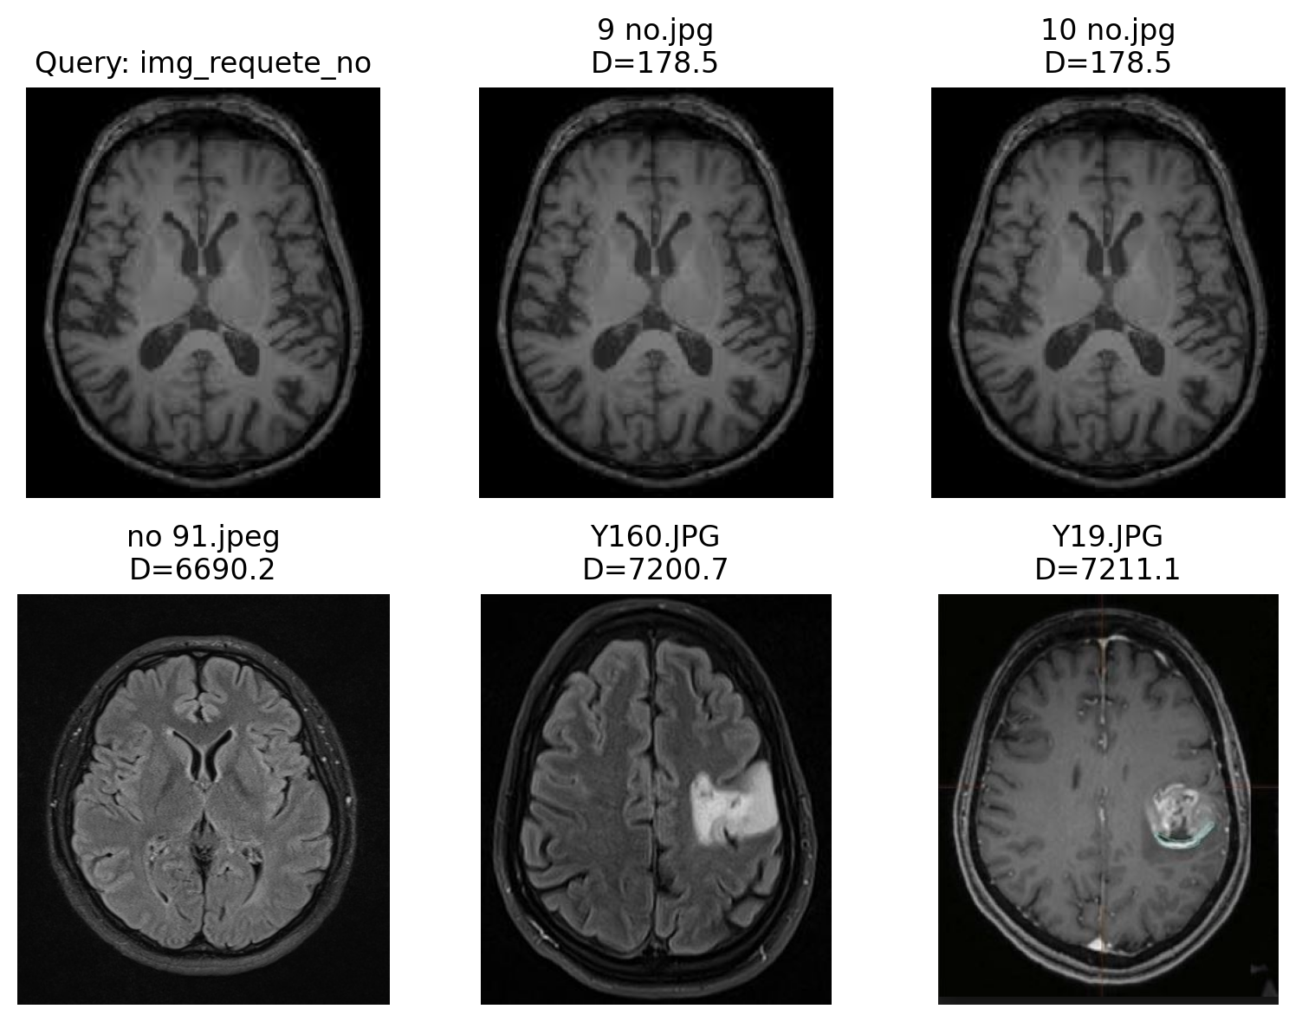

Slide 7
SVM
Support Vector Machines (SVM) are used for classification.
They separate tumor and non-tumor images.
They do this by finding the best line (or hyperplane) in the feature space.

Slide 8
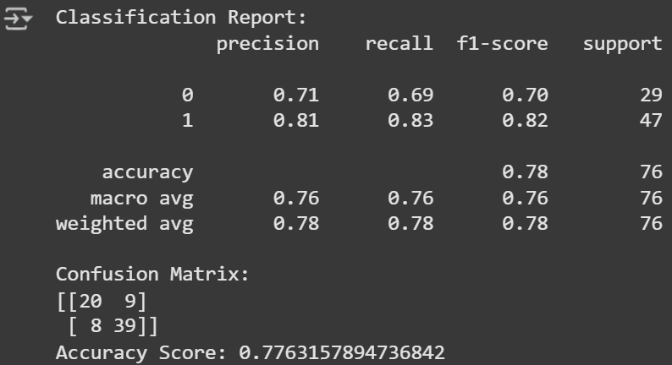
SVM

Slide 9
Search by color
Color-based features summarize an image using a few statistical values instead of individual pixels, then use these for classification.
Ensure the image is RGB (convert if needed).
Compute color moments for each channel (R, G, B): mean and standard deviation → 6 values total.
Normalize the 6-dimensional vector.
Feed it to a classifier.

Slide 10
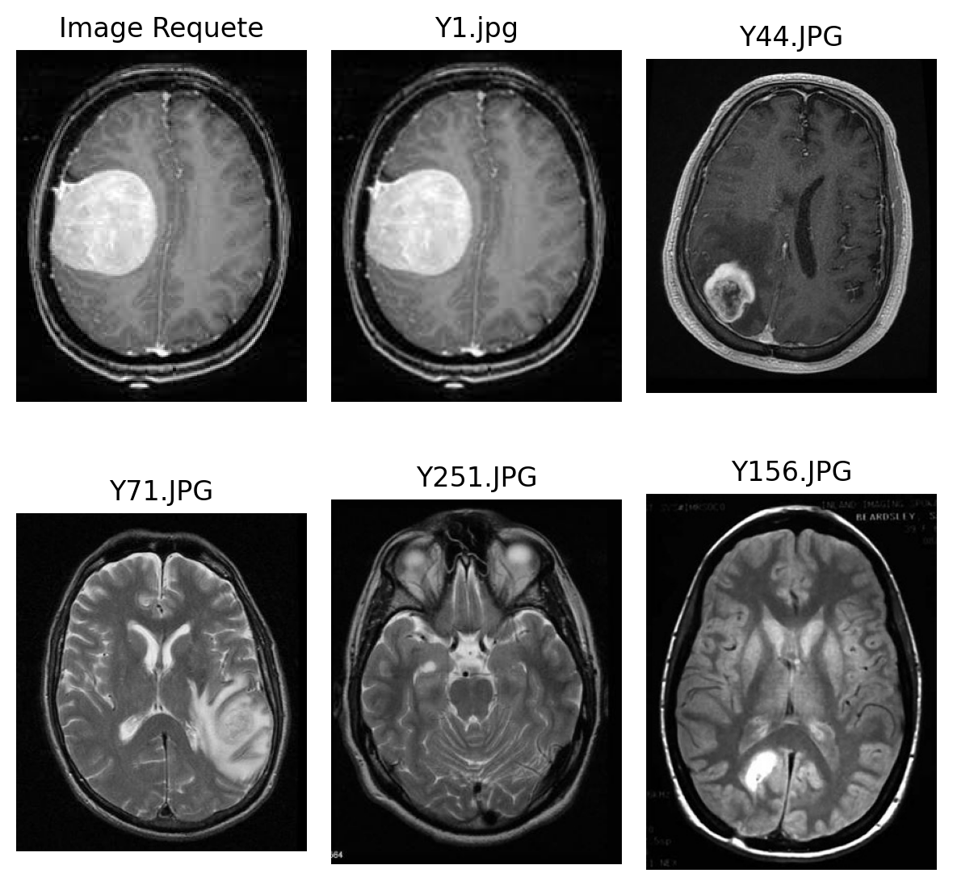
Search by color

Slide 11
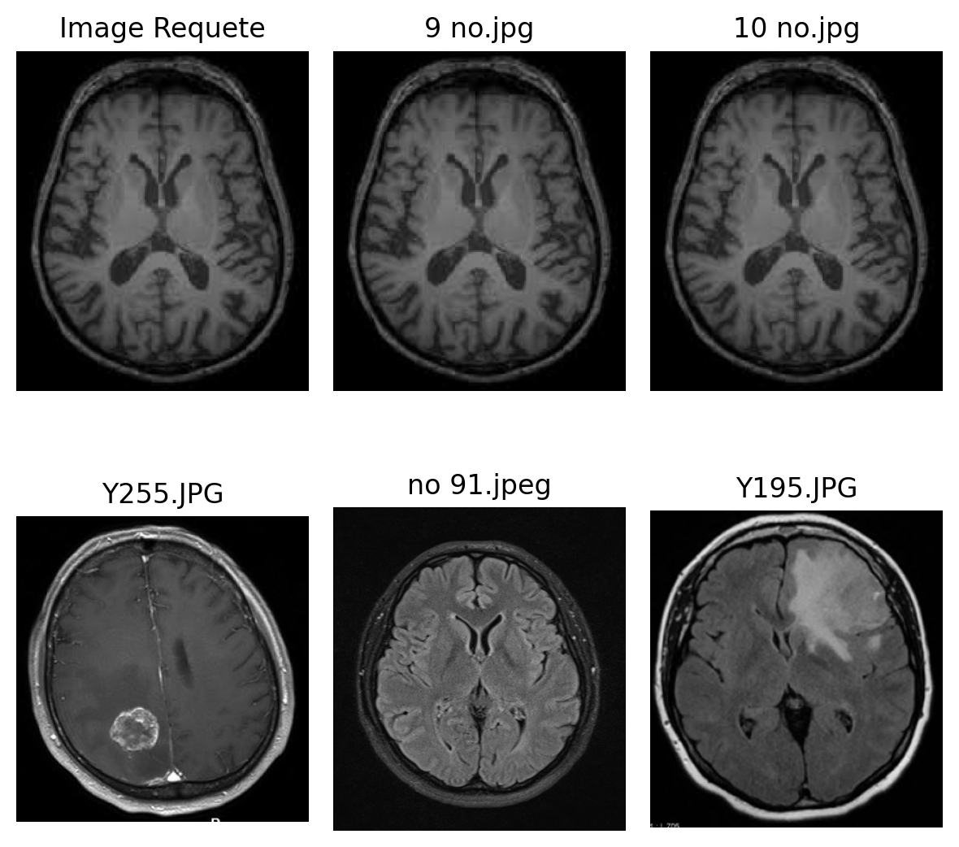
Search by color

Slide 12
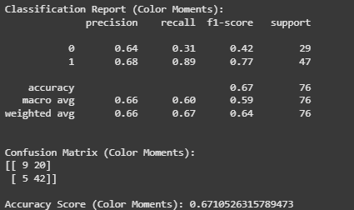
SVM

Slide 13
Robustness to rotation
Checks if the method can still detect and classify the tumor correctly even when the image is rotated.

Slide 14
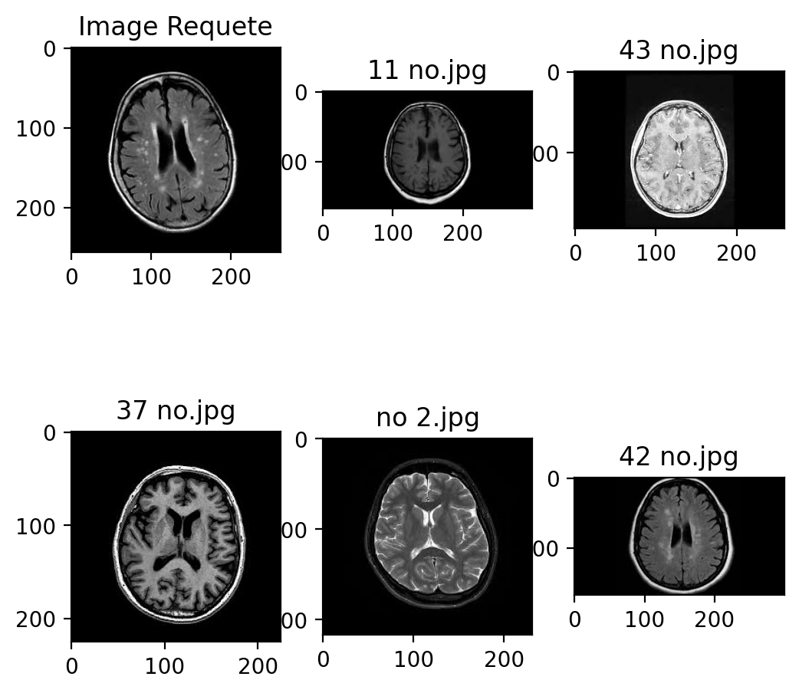
Robustness to rotation

Slide 15
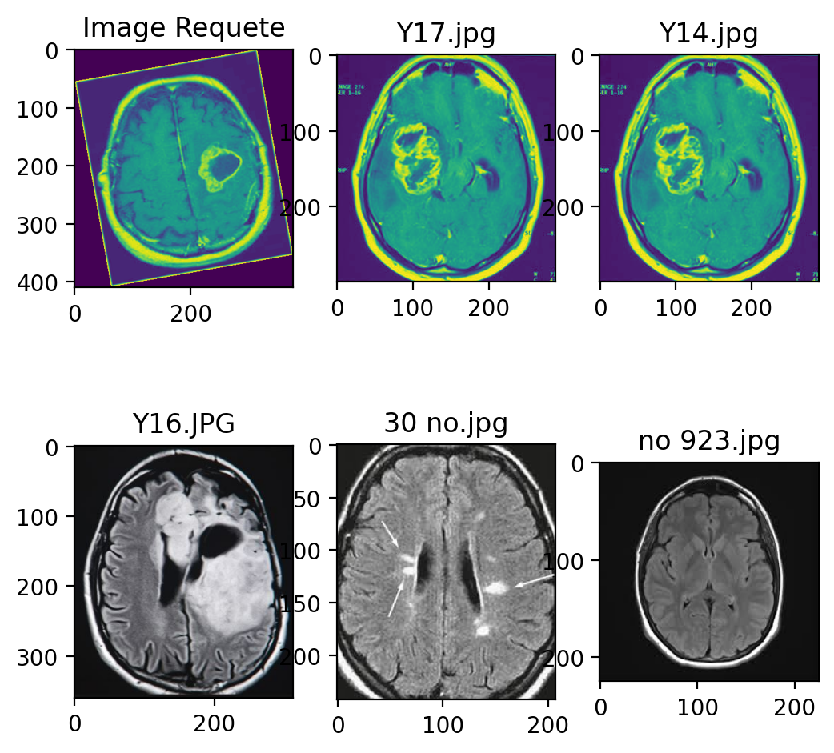
Robustness to rotation

Slide 16
Histogram-based retrieval
Histogram features show how pixel intensities are distributed.
They give a simple, compact description of the image.
However, they can lose information about where things are located.

Slide 17
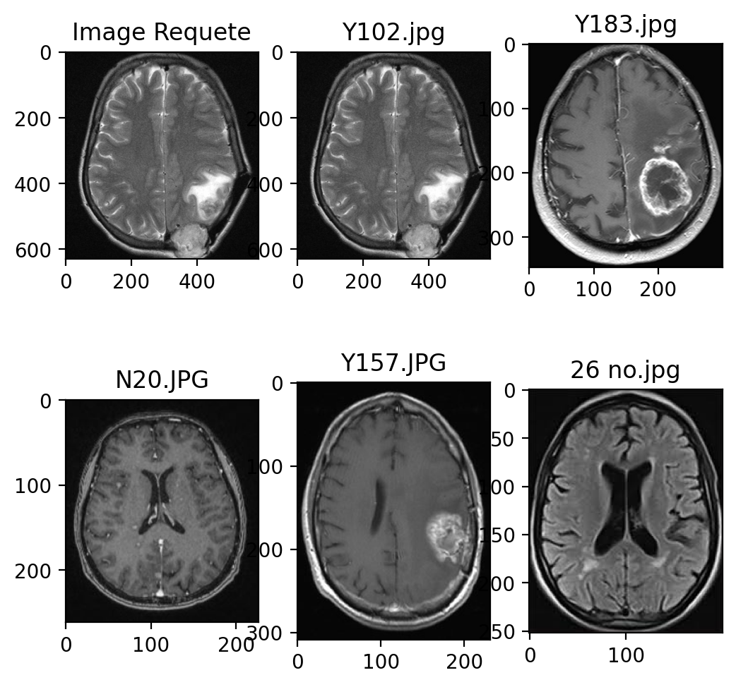
Histogram-based retrieval

Slide 18
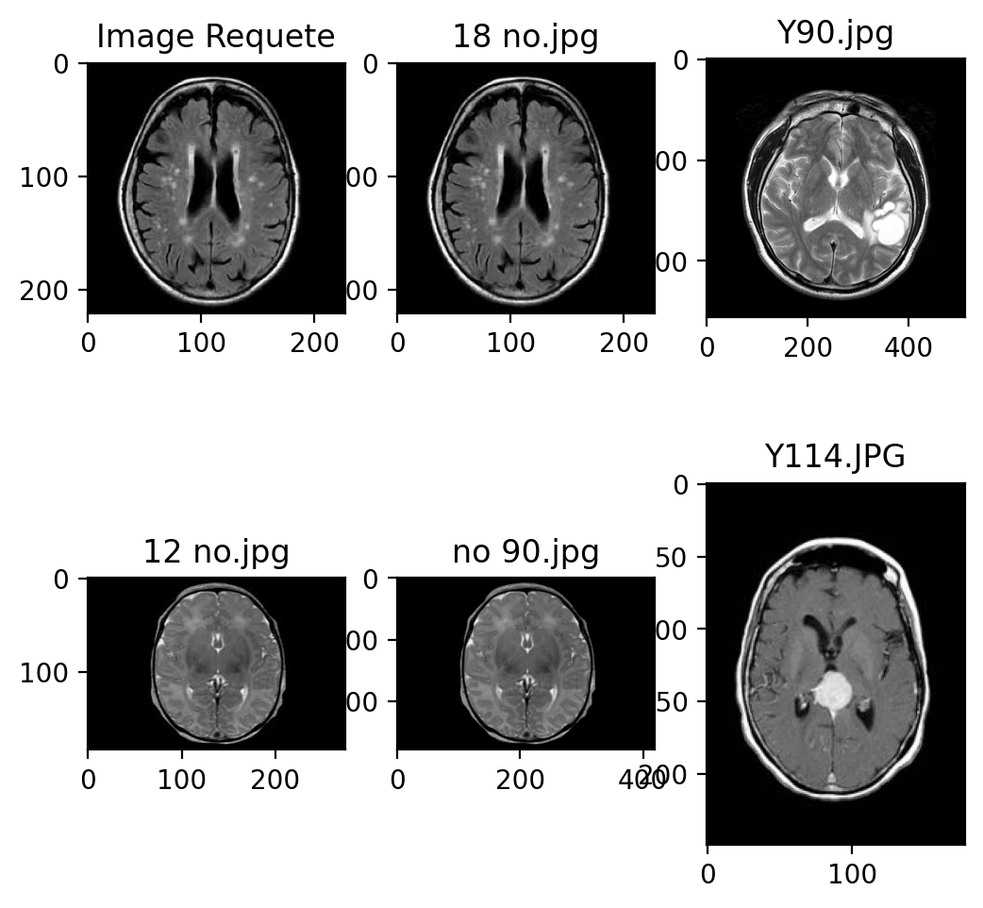
Histogram-based retrieval

Slide 19
Search by form
Tumor regions usually have irregular shapes.
Shape features are extracted to describe them.
This helps compare tumors regardless of their size or rotation.

Slide 20
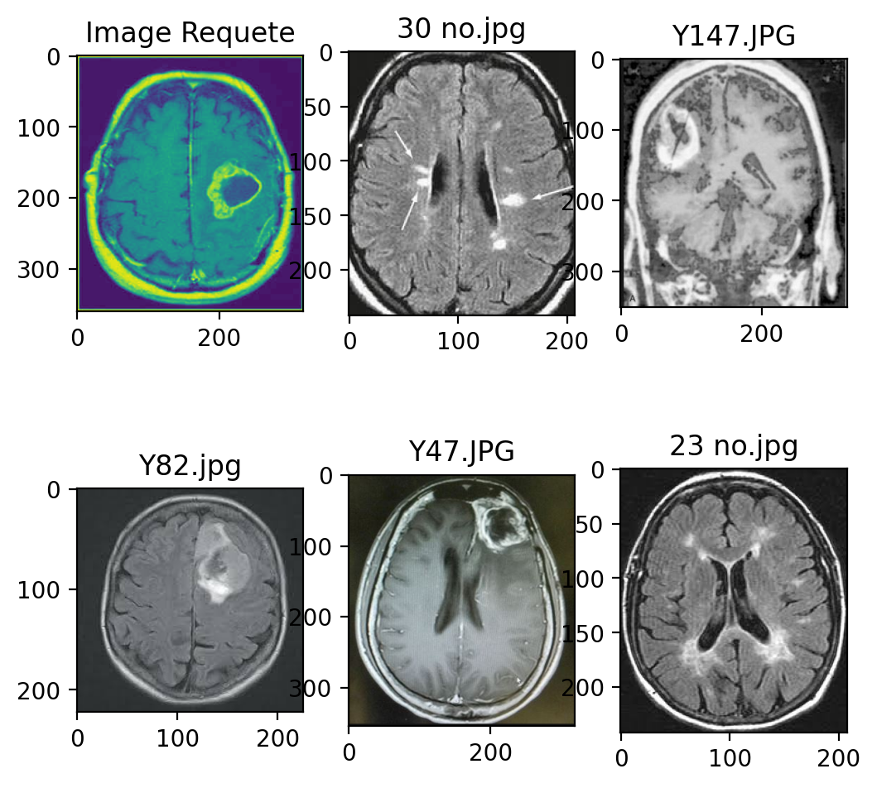
Search by form

Slide 21
Scale Invariant Feature Transform
SIFT finds important key points in the image that stay stable under changes.
It works even if the image is scaled, rotated, or has different lighting.
Each keypoint is described by a 128-value vector used for matching and classification.

Slide 22
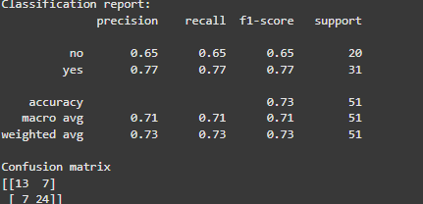
Scale Invariant Feature Transform +SVM

Slide 23
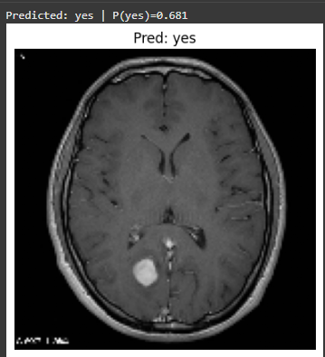
SIFT+SVM

